Slide 1



Internationalization & Universal Design

Slide 2
What Is Internationalization?
Internationalization is the process of designing for localization, or getting a design ready for internationalization, so that a product or service can be easily changed to fit different cultures, languages, and regions around the world. In other words, internationalization is about making sure your product or service can be used by people in different countries and cultures.

Slide 3
Process
This process involves things like translating the language, designing the user interface, taking cultural differences into account, and following local rules. It is important to remember that internationalization doesn’t just mean translating words; it also means understanding cultural nuances and making sure the product or service will work in any given market.

Slide 4
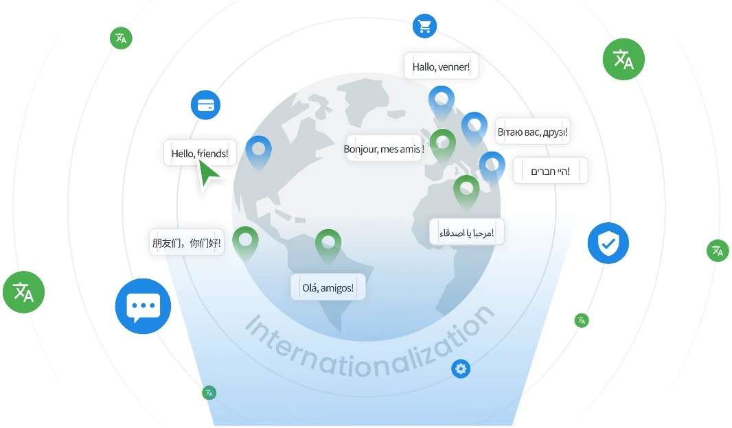
Design for Internationalization
Know Your Audience
Keep It Simple
Consider Cultural Differences
Use Common Symbols
Know What Colors Mean in Different Cultures
Plan for Text Growth
Test with a Global Audience

Slide 5
universal design principles
equitable use
flexibility in use
simple and intuitive to use
perceptible information
tolerance for error
low physical effort
size and space for approach and use

Slide 6
Multi-Sensory Systems
More than one sensory channel in interaction
  e.g. sounds, text, hypertext, animation, video, gestures, vision
Used in a range of applications:
  particularly good for users with special needs, and virtual reality
Will cover
  general terminology
  speech
  non-speech sounds
  handwriting
considering applications as well as principles

Slide 7
Usable Senses
The 5 senses (sight, sound, touch, taste and smell) are used by us every day
  each is important on its own
  together, they provide a fuller interaction with the natural world
Computers rarely offer such a rich interaction
Can we use all the available senses?
  ideally, yes
  practically – no
We can use • sight • sound • touch (sometimes)
We cannot (yet) use • taste • smell

Slide 8
Multi-modal vs. Multi-media
Multi-modal systems
  use more than one sense (or mode ) of interaction
    e.g. visual and aural senses: a text processor may speak the words as well as echoing them to the screen
Multi-media systems
  use a number of different media to communicate information
    e.g. a computer-based teaching system:may use video, animation, text and still images: different media all using the visual mode of interaction; may also use sounds, both speech and non-speech: two more media, now using a different mode

Slide 9
Speech
Human beings have a great and natural mastery of speech
  makes it difficult to appreciate the complexities
  but
  it’s an easy medium for communication

Slide 10
Structure of Speech
phonemes
  40 of them
  basic atomic units
  sound slightly different depending on the context they are in, these larger units are …
allophones
  all the sounds in the language
  between 120 and 130 of them
  these are formed into …
morphemes
  smallest unit of language that has meaning.

Slide 11
Speech (cont’d)
Other terminology:
• prosody
  alteration in tone and quality
  variations in emphasis, stress, pauses and pitch
  impart more meaning to sentences.
• co-articulation
  the effect of context on the sound
  transforms the phonemes into allophones
• syntax – structure of sentences
• semantics – meaning of sentences

Slide 12
Speech Recognition Problems
Different people speak differently:
  accent, intonation, stress, idiom, volume, etc.
The syntax of semantically similar sentences may vary.
Background noises can interfere.
People often “ummm.....” and “errr.....”
Words not enough - semantics needed as well
  requires intelligence to understand a sentence
  context of the utterance often has to be known
  also information about the subject and speaker
e.g. even if “Errr.... I, um, don’t like this” is recognised, it is a fairly useless piece of information on it’s own

Slide 13
The Phonetic Typewriter
Developed for Finnish (a phonetic language, written as it is said)
Trained on one speaker, will generalise to others.
A neural network is trained to cluster together similar sounds, which are then labelled with the corresponding character.
When recognising speech, the sounds uttered are allocated to the closest corresponding output, and the character for that output is printed.
  requires large dictionary of minor variations to correct general mechanism
  noticeably poorer performance on speakers it has not been trained on

Slide 14
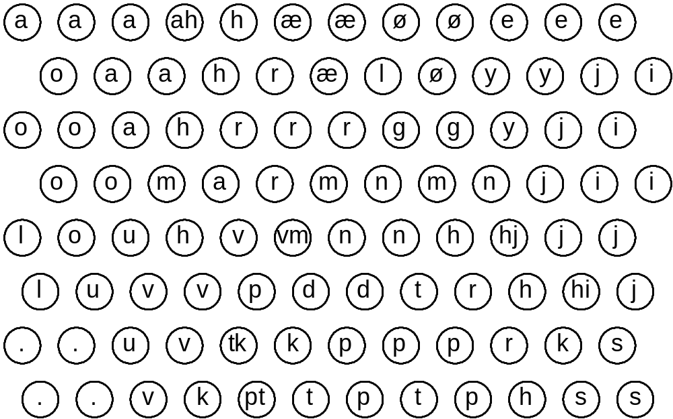
The Phonetic Typewriter (ctd)

Slide 15
Speech Recognition: useful?
Single user or limited vocabulary systems
e.g. computer dictation
Open use, limited vocabulary systems can work satisfactorily
e.g. some voice activated telephone systems
general user, wide vocabulary systems …
… still a problem
Great potential, however
  when users hands are already occupied
  e.g. driving, manufacturing
  for users with physical disabilities
  lightweight, mobile devices

Slide 16
Speech Synthesis
The generation of speech
Useful
  natural and familiar way of receiving information
Problems
  similar to recognition: prosody particularly
Additional problems
  intrusive - needs headphones, or creates noise in the workplace
  transient - harder to review and browse

Slide 17
Speech Synthesis: useful?
Successful in certain constrained applications
when the user:
  is particularly motivated to overcome problems
  has few alternatives
Examples:
screen readers
  read the textual display to the user
  utilised by visually impaired people
warning signals
  spoken information sometimes presented to pilots whose visual and haptic skills are already fully occupied

Slide 18
Non-Speech Sounds
boings, bangs, squeaks, clicks etc.
commonly used for warnings and alarms
Evidence to show they are useful
  fewer typing mistakes with key clicks
  video games harder without sound
Language/culture independent, unlike speech

Slide 19
Non-Speech Sounds: useful?
Dual mode displays:
  information presented along two different sensory channels
  redundant presentation of information
  resolution of ambiguity in one mode through information in another
Sound good for
  transient information
  background status information
e.g. Sound can be used as a redundant mode in the Apple Macintosh; almost any user action (file selection, window active, disk insert, search error, copy complete, etc.) can have a different sound associated with it.

Slide 20
Auditory Icons
Use natural sounds to represent different types of object or action
Natural sounds have associated semantics which can be mapped onto similar meanings in the interaction
e.g. throwing something away
~ the sound of smashing glass
Problem: not all things have associated meanings
Additional information can also be presented:
  muffled sounds if object is obscured or action is in the background
  use of stereo allows positional information to be added

Slide 21
SonicFinder for the Macintosh
items and actions on the desktop have associated sounds
folders have a papery noise
moving files – dragging sound
copying – a problem …
sound of a liquid being poured into a receptacle
rising pitch indicates the progress of the copy
big files have louder sound than smaller ones

Slide 22
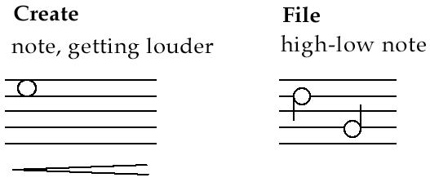
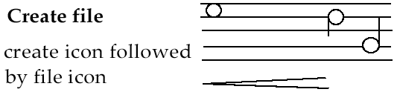
Earcons
Synthetic sounds used to convey information
Structured combinations of notes (motives ) represent actions and objects
Motives combined to provide rich information
  compound earcons
  multiple motives combined to make one more complicated earcon

Slide 23
Earcons (ctd)
family earcons
  similar types of earcons represent similar classes of action or similar objects: the family of “errors” would contain syntax and operating system errors
Earcons easily grouped and refined due to compositional and hierarchical nature
Harder to associate with the interface task since there is no natural mapping

Slide 24
touch
haptic interaction
  cutaneous perception
    tactile sensation; vibrations on the skin
  kinesthetics
    movement and position; force feedback
information on shape, texture, resistance, temperature, comparative spatial factors
example technologies
  electronic braille displays
  force feedback devices e.g. Phantom
    resistance, texture

Slide 25
Handwriting recognition
Handwriting is another communication mechanism which we are used to in day-to-day life
Technology
  Handwriting consists of complex strokes and spaces
  Captured by digitising tablet
    strokes transformed to sequence of dots
  large tablets available
    suitable for digitising maps and technical drawings
  smaller devices, some incorporating thin screens to display the information
    PDAs such as Palm Pilot
    tablet PCs

Slide 26
Handwriting recognition (ctd)
Problems
  personal differences in letter formation
  co-articulation effects
Breakthroughs:
  stroke not just bitmap
  special ‘alphabet’ – Graffeti on PalmOS
Current state:
  usable – even without training
  but many prefer keyboards!

Slide 27
gesture
applications
  gestural input - e.g. “put that there”
  sign language
technology
  data glove
  position sensing devices e.g MIT Media Room
benefits
  natural form of interaction - pointing
  enhance communication between signing and non-signing users
problems
  user dependent, variable and issues of coarticulation

Slide 28
Users with disabilities
visual impairment
  screen readers, SonicFinder
hearing impairment
  text communication, gesture, captions
physical impairment
  speech I/O, eyegaze, gesture, predictive systems (e.g. Reactive keyboard)
speech impairment
  speech synthesis, text communication
dyslexia
  speech input, output
autism
  communication, education

Slide 29
… plus …
age groups
  older people e.g. disability aids, memory aids, communication tools to prevent social isolation
  children e.g. appropriate input/output devices, involvement in design process
cultural differences
  influence of nationality, generation, gender, race, sexuality, class, religion, political persuasion etc. on interpretation of interface features
  e.g. interpretation and acceptability of language, cultural symbols, gesture and colour

